Slide 1
The College and Scholarship Application Processes
A PRESENTATION BY:
SADDLE BROOK HIGH SCHOOL
SCHOOL COUNSELING DEPARTMENT
SEPTEMBER 26, 2019

Slide 2
College Testing: The ACT and the SAT

Slide 3
ACT
TEST DATE: | REGISTER BY:
October, 26, 2019 | Sept. 20, 2019 (Late Registration Oct. 4, 2019)
December 14, 2019 | Nov. 8, 2019
February 8, 2020 | Jan 10, 2020

Slide 4
Registration for ACT
Online Registration –
www.actstudent.org

Slide 5
SAT
TEST DATE: | REGISTER BY:
October 5, 2019 | Passed
November 2, 2019 | Oct. 3
December 7, 2019 | Nov. 8
Most colleges prefer that seniors complete testing by the end of December.

Slide 6
Registration for SAT
Students can register online at
www.collegeboard.com

Slide 7
What is the SAT II?
Additional tests, often referred to as Subject Tests, may be required by some schools
RECOMMENDED by the most competitive colleges
Used for admissions and/or placement purposes
Students are required to take 2 or 3 Subject Tests (check with each college) in subject area of choice (Math, History, etc.)
Notes:
Administered on same schedule as SAT Reasoning
Some schools accept ACT in lieu of SAT Subject Tests

Slide 8
Testing-Optional Schools
Some colleges follow a “testing (SAT/ACT) optional” policy, meaning that test scores are not required for application or admission.
A list of testing-optional schools can be found at www.fairtest.org
(Hover over the “College Admissions” tab and click “Optional List.”)

Slide 9
Reminder:
SENIOR GRADES DO MATTER!!!

Slide 10
Types of Applications
School Specific Applications
Self –Reporting School Applications
Common Application & Coalition Application

Slide 11
Rutgers University School-Specific Application
Rutgers requires no forms, paperwork, or transcripts from SBHS
Complete an online Self-Reported Academic Record (SRAR)
Enter your State Smart Identification Number (SSID)
Located on unofficial transcript which can be obtained in the Guidance Office.

Slide 12
School Supporting Documentation “What we send”
After receiving a Senior Documentation Request:
Official Transcript
Letters of Recommendation (as many as required and requested)
Grades – whatever is available at the time of submission
1 Counselor letter of recommendation
Secondary school report
School profile

Slide 13
Process for Requesting School Documents
What students/parents submit:
Senior Doc Request Form– one for each college; meet with counselor
AND
Confirm that required information has been entered into Naviance by student.

Slide 14
Schedule for Submitting Transcript and Recommendation Requests
We need at least two weeks to submit your requests
Can take up to six weeks for colleges to record it as being received
If college/university application deadline is… | …your Transcript Request must be made on or before…
November 1, 2019 | October 18, 2019
November 15, 2019 | October 25, 2019
December 1, 2019 | November 13, 2019
December 15, 2019 | November 27, 2019
January 1, 2020 or after | December 5, 2019

Slide 15
Common App vs. College App vs. Naviance
Common App | College App | Naviance
Used by Students | Used by Students | Used by Students & School Counseling Office
Must be filled out | Some schools will use their own web-based application | Will be used to send out your: Official Transcript School Profile Letters of Recommendation
Your Login ID + Passwords + Date of Birth need to be synced to Naviance | Sometimes they will waive or reduce application fee | Students will complete their FERPA waiver
 | Some schools will still accept paper applications | Students can check the submission status of their transcript and letters of recommendation

Slide 16
Completing Applications
Start Early
Follow directions
Meet deadlines
Allow time for writing and reviewing
SAVE OFTEN!

Slide 17
Essay/Personal Statement

Slide 18
In most cases, the essay is in lieu of an in-person interview.
What do you want them to know about you?
It’s your time to shine!
How are you different from everybody else?
Do not underestimate the power of a well-written statement.
Accepted or not accepted? Scholarship or no scholarship?

Slide 19
Back to Basics…
** Proofread, Proofread, and PROOFREAD!**
Ask a teacher, parent, or counselor to review and proofread your essay!
Check for:
Typos
Spelling
Grammar
Punctuation
Capitalization
Incorrect usage can be interpreted as careless!

Slide 20
Most Common Mistakes…
“After I graduate form high school, I plan to work…”
“after i graduate from saddle brook high school, i plan to work…”
“BTW after I graduate it will be GR8.” THNX for your consideration.”
There, their, they’re
Making reference to the wrong school –
“Dear Harvard University,
All of my life I have dreamed of attending Yale University.
Sincerely,
The student who did not proofread!”

Slide 21
Scholarships

Slide 22
Types of Scholarships
Institutional (merit or needs-based scholarships)
Money available through the college or university
Some colleges or universities may require special forms or applications to be considered for scholarships
BE MINDFUL OF DEADLINES!!!
A great resource for researching merit scholarships – www.meritaid.com
Activity / Major-specific
Ex. – sports, community service, accounting, music
Employers
Given to employees, the children or relatives of employees, or the children of deceased or retired employees

Slide 23
Types of Scholarships (cont.)
Local Organizations
Ex. – Saddle Brook Education Foundation, Saddle Brook UNICO
SCHOLARSHIP INFORMATION WILL BE AVAILABLE ON THE SADDLE BROOK HIGH SCHOOL GUIDANCE/COUNSELING WEBSITE IN LATE FALL
*WHEN APPLICABLE, PAPER APPLICATIONS WILL BE AVAILABLE IN THE GUIDANCE/SCHOOL COUNSELING OFFICE*

Slide 24
Sources for Scholarship Information
Saddle Brook High School Guidance/School Counseling Dept. and website
Naviance
College websites, applications, and academic course books
College visitations and information sessions
Internet search engines –
Studentscholarships.org
Collegeboard.com
Fastweb.com
Careeronestop.org

Slide 25
Scholarship Application Procedures
Students may be required to submit transcripts as part of the application process
Submit no less than 10 SCHOOL DAYS PRIOR TO DEADLINE
Request transcript for scholarship using
SBHS SENIOR DOCUMENT REQUEST FORM located in Guidance/School Counseling Office

Slide 26
Financial Aid Forms
https://www.hesaa.org/Pages/NJFAFSAGo.aspx
FAFSA (Free Application for Federal Student Aid) –
In order to be considered for federal, state, or campus-based financial aid, a FAFSA form must be completed and submitted to the federal government:
https://fafsa.ed.gov/
Submit as soon as possible after October 1st
https://www.hesaa.org/Pages/NJFAFSAGo.aspx
Helpful resources to assist with the FAFSA process
Note: SBHS Guidance/School Counseling Dept. hosted a FAFSA Workshop presented by NJ HEESSA in April 2019 (power point is available on the Guidance webpage.

Slide 27
Financial Aid Forms (cont.)
CSS Profile (College Search Service)
The CSS/Financial Aid Profile is required by some private colleges and organizations.
There are fees for using the Profile.
CSS Profile must be completed and submitted online at www.collegeboard.com

Slide 28
Naviance
Students use Naviance for
ALL College, Career and Military Applications.

Slide 29
Log-on procedures
Go to the SBHS GUIDANCE homepage.
On the left hand side, click Naviance.
If you have forgotten your username or password, you can also contact your counselor to reset it for you.

Slide 30
Reminder:
Check your Senior Checklist to assure that you have completed all tasks required.
See your counselor if you have any questions.

Slide 31
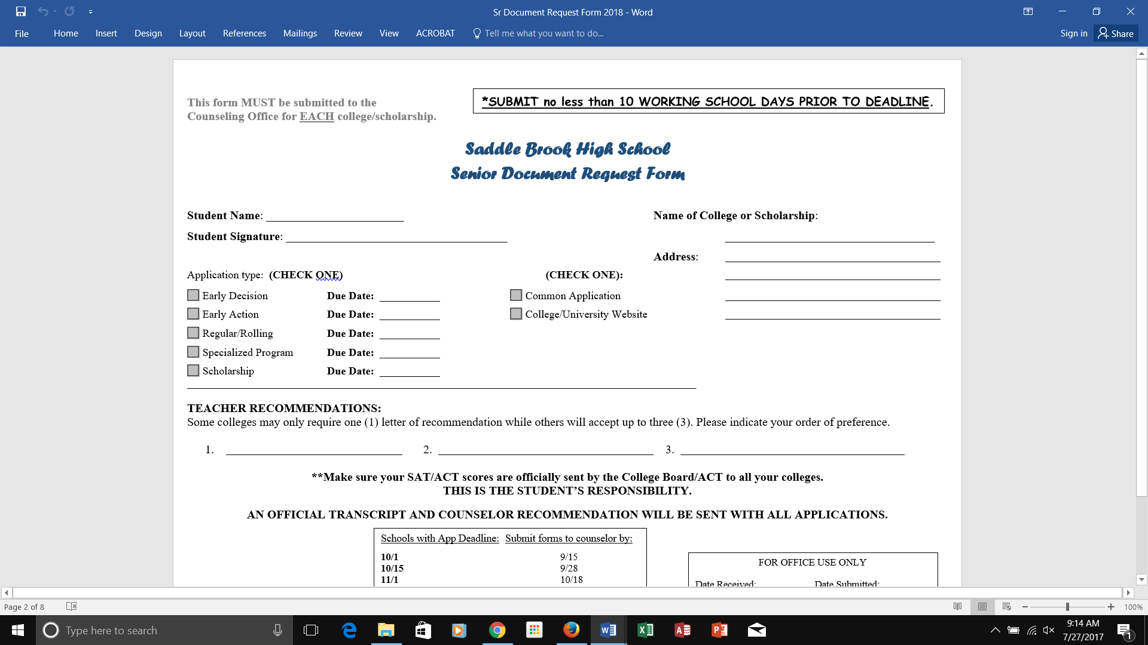
Sr Document Request Form

Slide 32
Upcoming College-Related Events
Open Houses
College Tours
College Representatives to SBHS –
Schedule updated in the Counseling Office
University of Alabama- 9/27/2019
Western Connecticut University- 10/4/2019
Montclair University- 10/4/2019TCNJ- 10/8/2019
University of Rhode Island- 10/16/2019
William Paterson University- 10/17/2019

Slide 33
To Do Checklist
Set up application accounts and utilize Naviance
Inform counselor if log-on information for Naviance is needed in order to complete common application account matching
Turn in Senior Document Form for each application submitted
Provide your “Brag Sheet” for counselor/teacher recommendations
Parents can access FAFSA worksheets and/or financial aid estimator in preparation for completing official FAFSA after October 1st , 2019:
http://www.finaid.org/calculators/finaidestimate.phtml

Slide 34
Thank you for attending & Good Luck!
There are approximately over 5,400 schools in the US. We are here to support you and will answer your questions to best of our ability.
Colleges/Universities all have specific criteria for Admission and
at times “Schools” within the University may have additional criteria.
(information can be found on the specific school’s website.)
When in doubt call the College.
Ms. Marta Benito, Counselor
Ms. Kimberly Gerken, Counselor
Ms. Christina Sasson, Counselor
Kayla Presutti, Administrative Assistant

